Slide 1
The History of MAsk

Slide 2
What jobs or careers require people to wear masks?
Who wears masks in society?
What is the difference between a literal and metaphorical mask
Is wearing a social mask a universal human experience? Explain

Slide 3
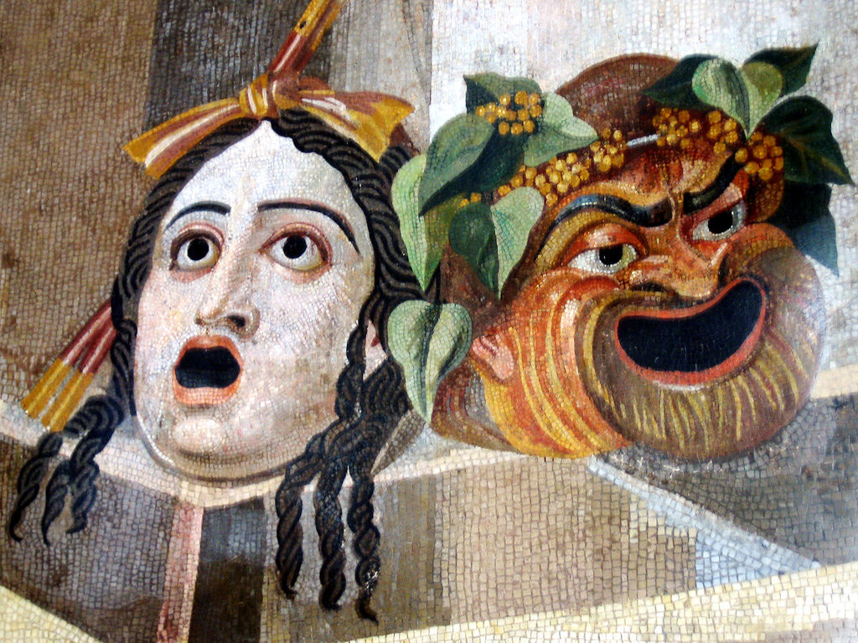
Greek theatre
Because the number of actors varied from one to three, they had to put on different masks, in order to play more roles.
The actors were all men. The mask was therefore necessary to let them play the female roles. Picture 2 portrays a woman's mask.

Slide 4
2 pieces of knowledge about greek masks

Slide 5
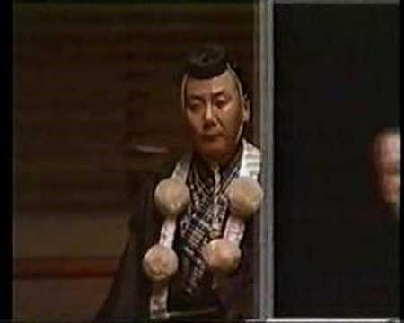
Noh Theatre

Slide 6
3 pieces of knowledge about greek masks

Slide 7
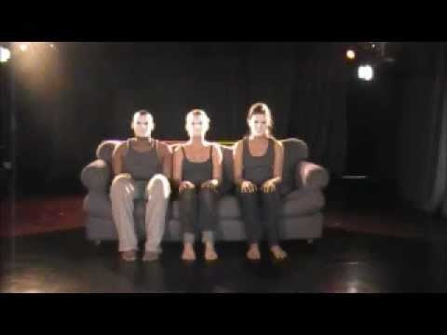
How to move with a mask

Slide 8
What did you notice about the movement/story?

Slide 9
Brain gym to music
Heavy, light, big, small, combo, find something you treasure, share with class.

Slide 10
Create your own neutral mask piece telling a story in groups of 2 or 3
The more simple the better. Choose instrumental music.

Slide 11
Button Exercise
Walk around with the button. What’s its story?
write down all your know about this character. Life story. Hopes. Dreams. What piece of clothing did this button come from?

Slide 12
Create a character mask and walk based on this button

Slide 13
Tell a story of the character. Show them to us.

Slide 14
Display clarity of movement and gesture. /3
Use exaggerated movement and gesture. /3
Display clarity of movement and gesture. /3
Use exaggerated movement and gesture. /3
Communicate environment, character, and situation non-verbally /3

